Slide 1
2nd ANNUAL GLOBAL SURVEY RESULTS
2020 World Engineering Day
Executive Summary: March 4, 2020

Slide 2
The 2nd Annual Global Survey
DiscoverE launched Global Day of the Engineer in 2016 and completed the first-ever global survey in 2019. For 2020, DiscoverE joined forces with WFEO and UNESCO to coordinate World Engineering Day for Sustainable Development. As part of this celebration, we launched a second survey to explore the future of engineering, asking about daunting global challenges, our ability to solve these challenges and what factors might limit us.

Slide 3
Methodology & Background
The 2nd annual Global Engineer Survey was developed by DiscoverE in collaboration with our partners at WFEO and Concord Evaluation Group. The online survey launched on November 11, 2019 and closed on January 17, 2020.
To ensure the highest levels of participation, DiscoverE asked coalition partners around the world to help spread the word.
The 12-question survey was administered through Survey Monkey and was available in six languages (English, Spanish, Chinese, Arabic, Russian, French).
The survey findings were shared on March 4, 2020—World Engineering Day.
We cross-tabulated select questions by country and discipline.

Slide 4
Study Participants
10,077 Participants
82% Engineers (8,232)
8% Technologists (813)
7% Technicians (705)
3% None of the above (327)

Slide 5
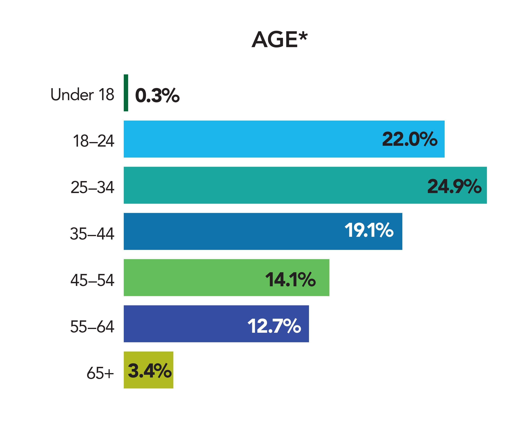
Study Participants
*Missing data from 3.5% of respondents.

Slide 6
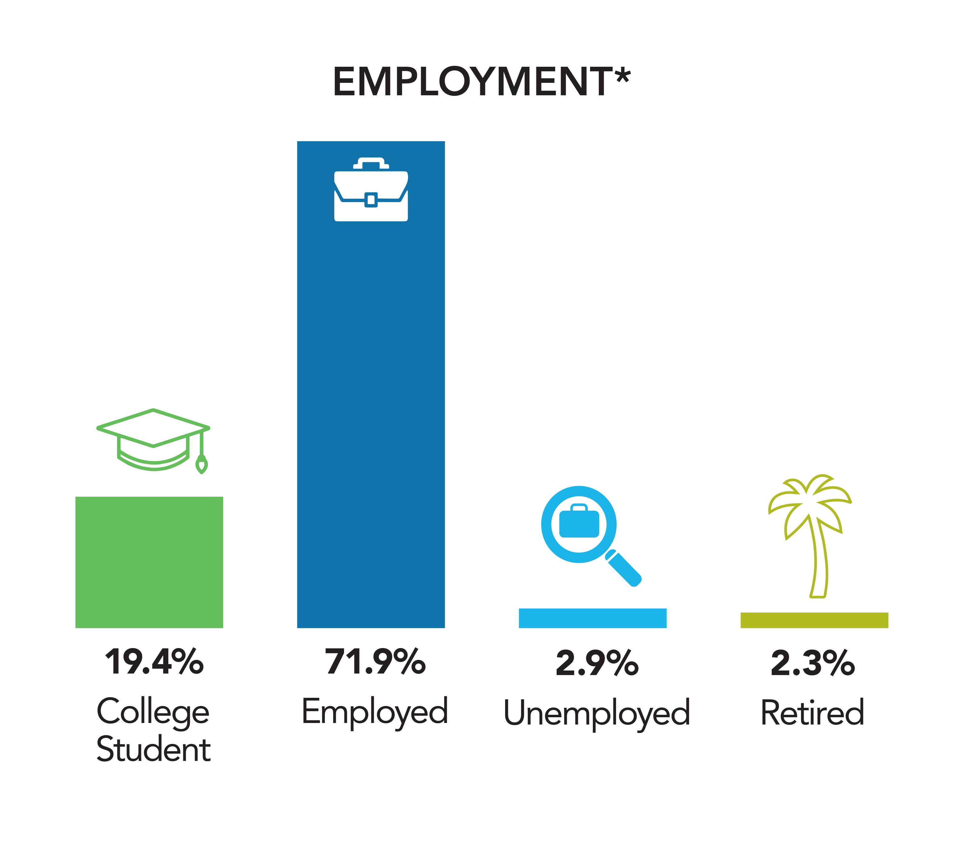
Study Participants
*Missing data from 3.5% of respondents.

Slide 7
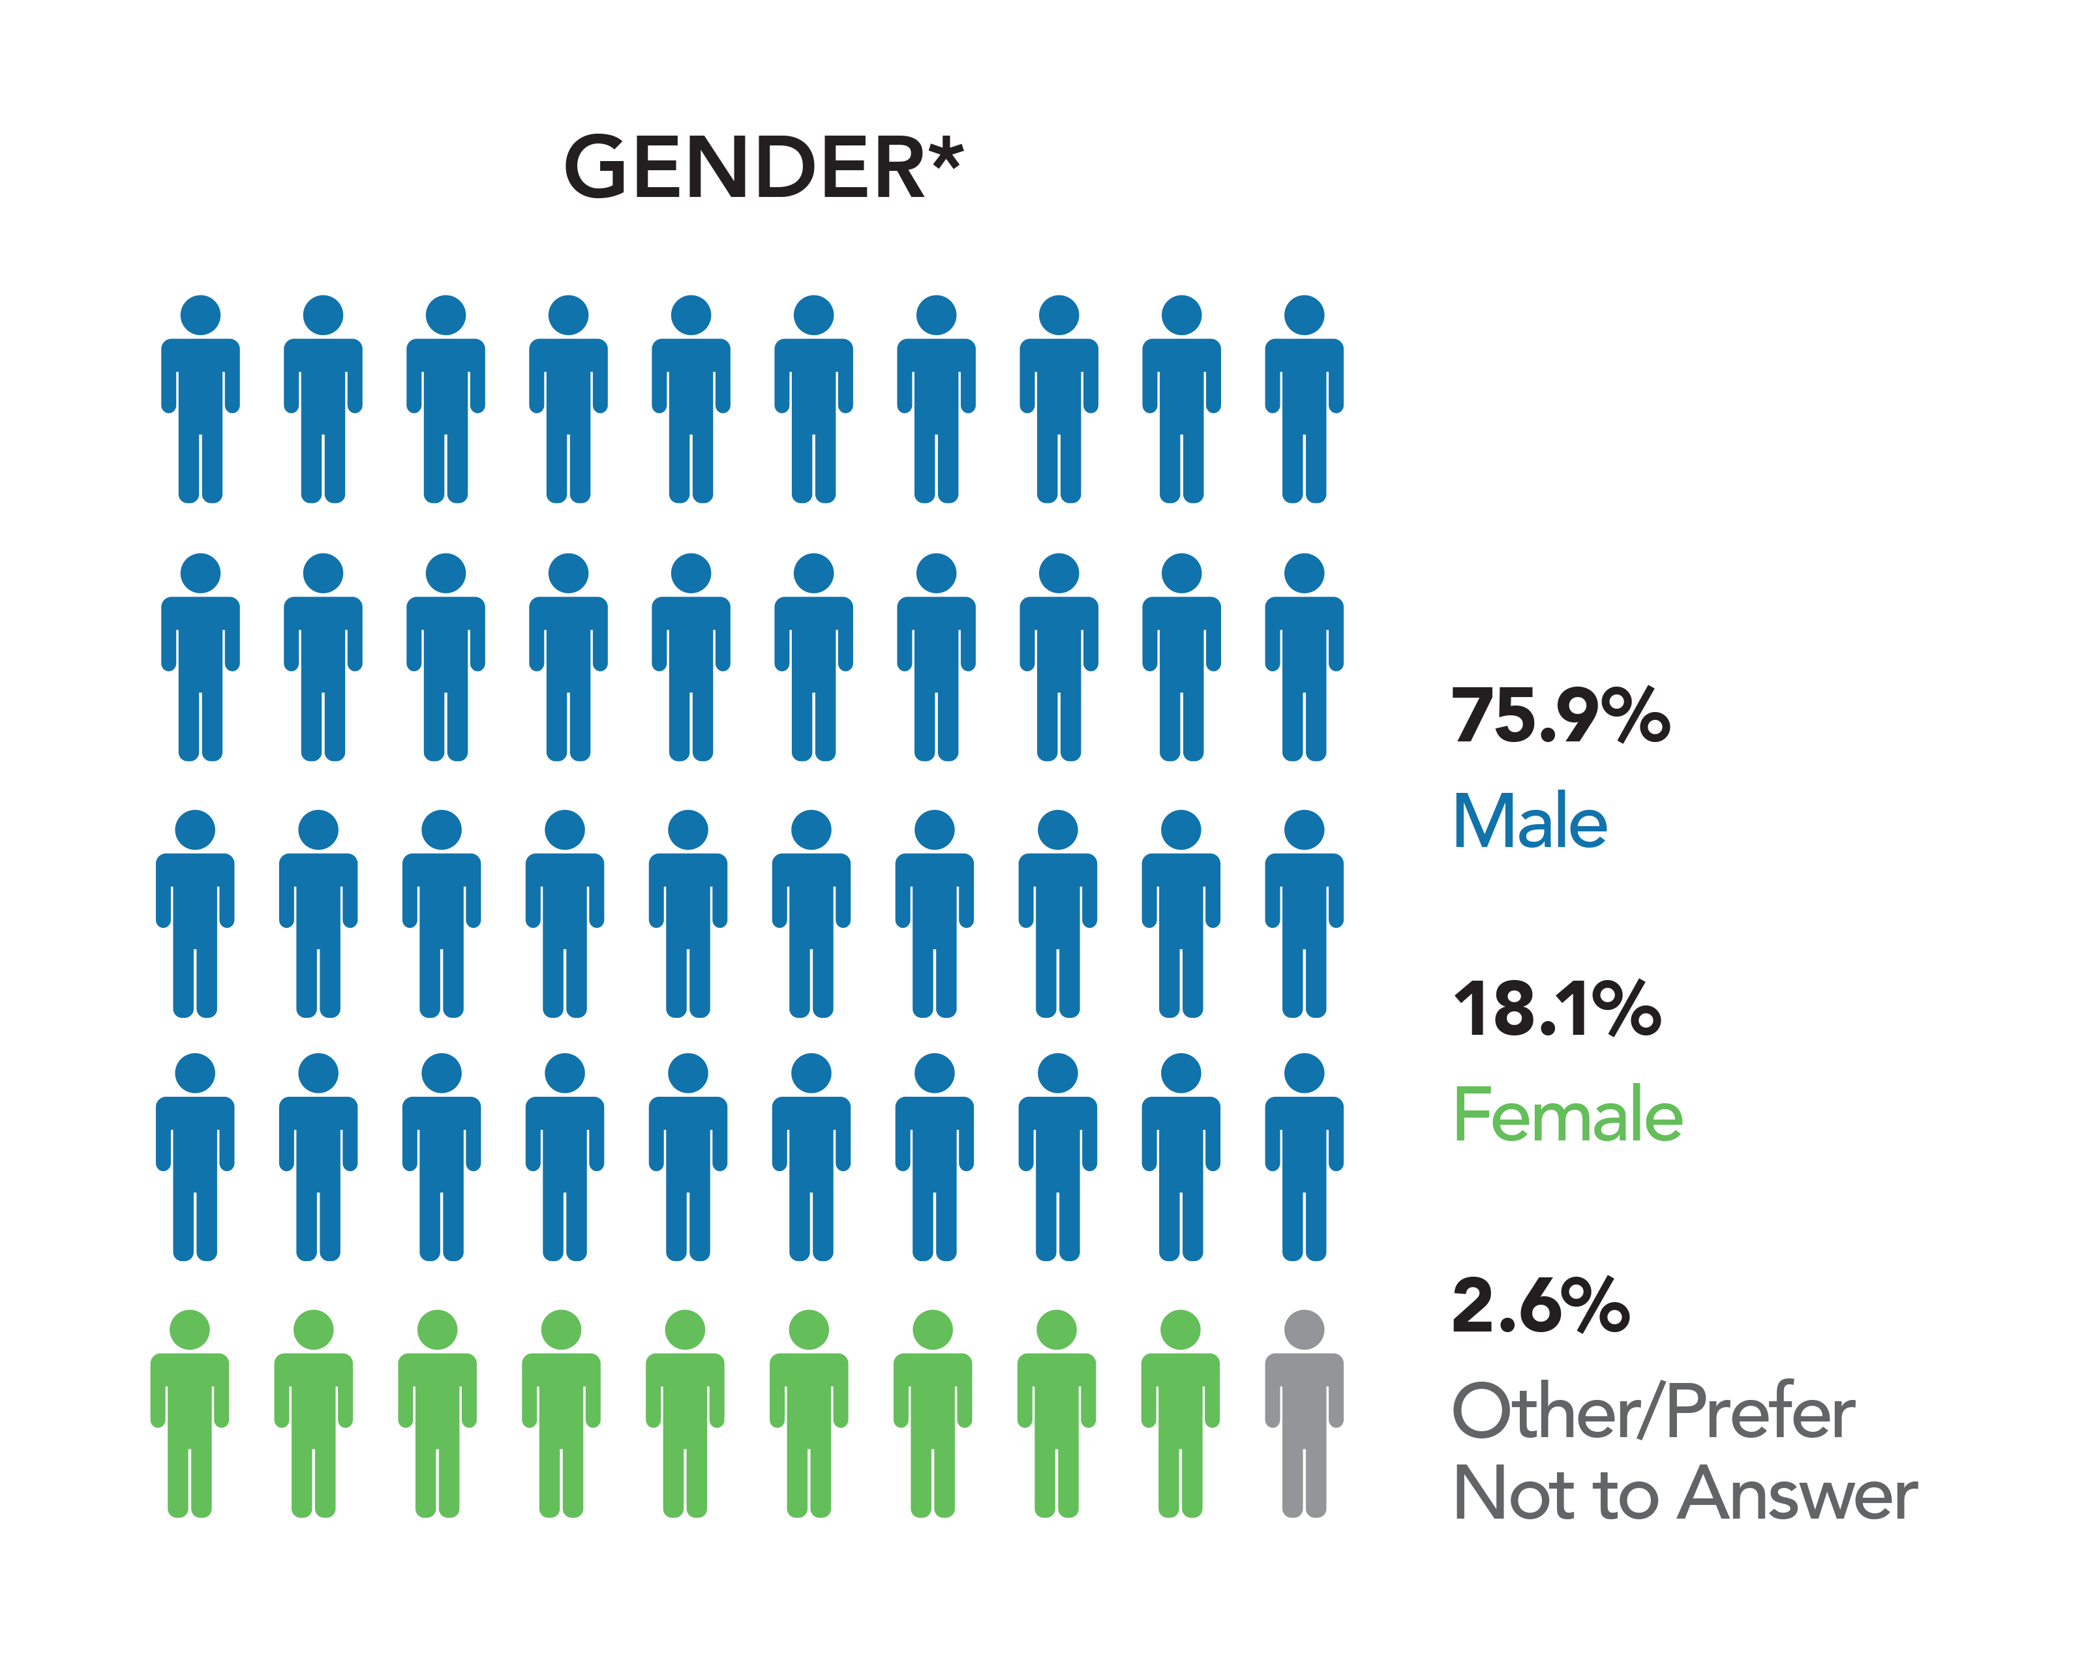
Study Participants
*Missing data from 3.5% of respondents.

Slide 8
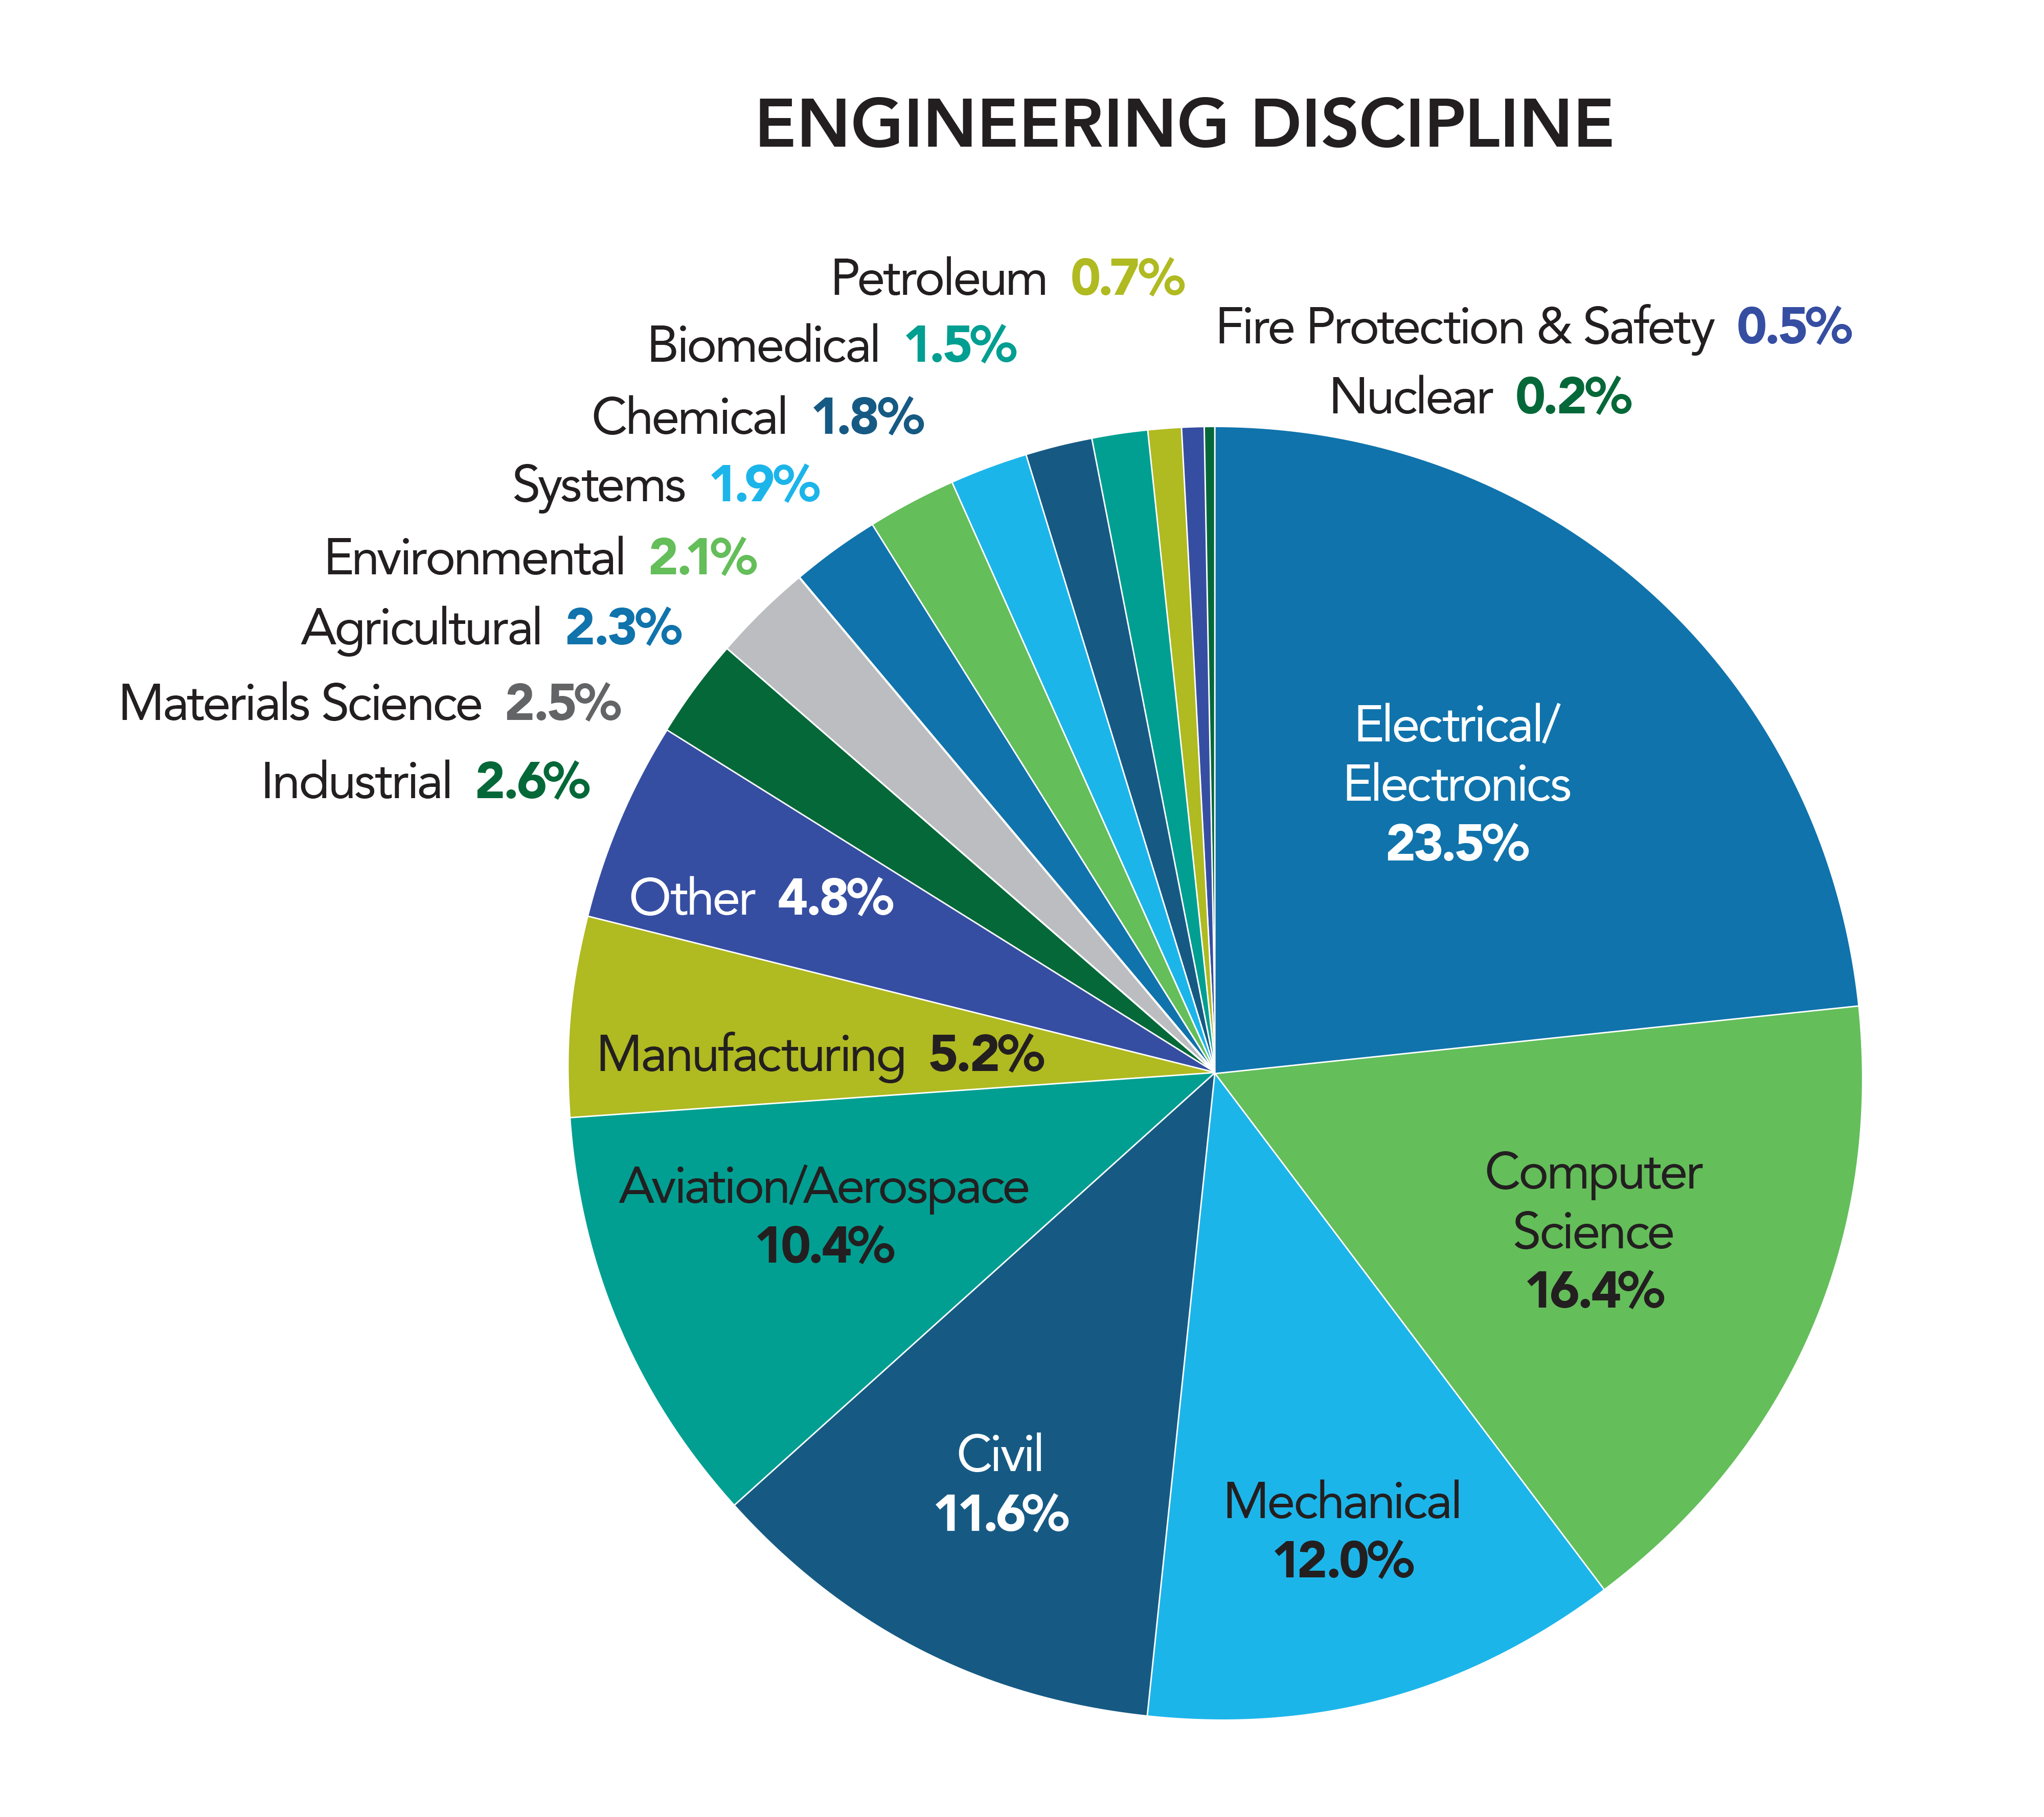
Study Participants

Slide 9
What Is the Most Daunting Global Challenge We Will Face in the Next 25 Years?
Securing Cyberspace 19%
Economical Clean Energy 18%
Sustaining Lands and Oceans 16%
Sustainable and Resilient Infrastructure 11%
Sustainable Cities 9%
Access to Clean Water and Sanitation 8%
Clean Air 8%
Food Security 4%
Preparing and Containing Pandemics 4%
Developing and Delivering Better Medicines 4%
Note: The survey was administered from 11/2019 to 1/17/2020, before the current coronavirus outbreak made international news
Notes:
c

Slide 10
By Respondent’s Country: Top Two Global Challenges
USA
Securing Cyberspace 27%
Sustaining Lands and Oceans 17%
China
Sustaining Lands and Oceans 20%
Economical Clean Energy 18%
Europe
Economical Clean Energy 25%
Sustaining Lands and Oceans 16%

Slide 11
By Respondent’s Country: Top Two Global Challenges
Iraq
Economical Clean Energy 25%
Clean Air 18%
Kenya
Access to Clean Water 23%
Sustainable Cities 20%
All Others
Sustaining Lands and Oceans 18%
Economical Clean Energy 17%

Slide 12
By Respondent’s Discipline: Top Two Global Challenges
Aviation/Aerospace
Securing Cyberspace 27%
Sustaining Land and Oceans 18%
Civil
Sustainable and Resilient Infrastructure 21%
Sustainable Cities 18%
Computer Science
Securing Cyberspace 31%
Sustaining Land and Oceans 16%

Slide 13
By Respondent’s Discipline: Top Two Global Challenges
Electrical
Securing Cyberspace 20%
Economical Clean Energy 20%
Mechanical
Economical Clean Energy 25%
Sustaining Land and Oceans 16%
All Others
Sustaining Land and Oceans 18%
Economical Clean Energy 17%

Slide 14
By Respondent’s Job Title & Gender: How Optimistic Are You That the Engineering Community Can Solve These Challenges?
By Job Title
Technologists 67.55
Technicians 65.11
Engineers 60.90
By Gender
Men 63.78
Women 56.52
*Respondents were asked to rate their optimism level on a scale from 1 to 100.

Slide 15
By Respondent’s Age and Employment: How Optimistic Are You?
By Age
18 – 24 66.22
25 – 34 59.43
35 – 64 62.00
Over 65 60.65
By Employment Status
College Student 69.42
Employed 60.40
Retired 61.02
Unemployed 57.19
*Respondents were asked to rate their optimism level on a scale from 1 to 100.

Slide 16
By Challenge: How Optimistic Are You?
Developing and Delivering Better Medicines 64.58
Securing Cyberspace 64.21
Economical Clean Energy 64.01
Sustainable and Resilient Infrastructure 62.89
Sustainable Cities 63.28
Access to Clean Water and Sanitation 61.40
Clean Air 60.96
Food Security 60.32
Preparing and Containing Pandemics 58.97
Sustaining Lands and Oceans 56.92
*Respondents were asked to rate their optimism level on a scale from 1 to 100.

Slide 17
What Are the Limiting Factors to Solving These Challenges?
Necessary support from government & policy makers is lacking 29.3%
Necessary technologies have not yet been developed 13.3%
Lack of interdisciplinary collaboration & international cooperation 12.5%
Not enough public support for innovative engineering solutions 9.8%
Lack of funding 9.7%
Not enough engineers & technical professionals to address the issue 7.0%
Lack of diversity in the workforce 4.9%
Don’t know 4.7%
Other 4.5%
Day-to-day work pressures 4.3%

Slide 18
By Respondent’s Discipline: Top Two Limiting Factors
Aviation/Aerospace
Necessary support from government & policy makers is lacking 36%
Necessary technologies have not yet been developed 12%
Civil
Necessary support from government & policy makers is lacking 35%
Lack of funding 13%
Computer Science
Necessary support from government & policy makers is lacking 25%
Necessary technologies have not yet been developed 15%

Slide 19
By Respondent’s Discipline: Top Two Limiting Factors
Electrical
Necessary support from government & policy makers is lacking 26%
Necessary technologies have not yet been developed 16%
Mechanical
Necessary support from government & policy makers is lacking 29%
Necessary technologies have not yet been developed 14%
All others
Necessary support from government & policy makers is lacking 30%
Lack of interdisciplinary collaboration & international cooperation 13%
Notes:
c

Slide 20
By Respondent’s Country: Top Two Limiting Factors
USA
Necessary support from government & policy makers is lacking 34%
Lack of funding 12%
China
Necessary technologies have not yet been developed 21%
Necessary support from government & policy makers is lacking 16%
Europe
Necessary support from government & policy makers is lacking 34%
Lack of interdisciplinary collaboration & international cooperation 15%

Slide 21
By Respondent’s Country: Top Two Limiting Factors
Iraq
Necessary support from government & policy makers is lacking 45%
Not enough public support support for innovative engineering 10%
Kenya
Necessary support from government & policy makers is lacking 45%
Lack of Interdisciplinary collaboration & international cooperation 19%
All Others
Necessary technologies have not yet been developed 36%
Lack of Interdisciplinary collaboration & international cooperation 15%

Slide 22
Shortage of Engineers
There is a current shortage of engineers
Agree or strongly agree 51.7%
Neutral 29.1%
Disagree or strongly disagree 19.2%
There will be a shortage of engineers in the future
Agree or strongly agree 54.3%
Neutral 24.4%
Disagree or strongly disagree 21.3%

Slide 23
By Respondent’s Country: Shortage of Engineers
There is a current shortage of
engineers*
USA 3.60
China 3.44
Europe 3.50
Kenya 3.38
Iraq 2.50
All others 3.10
There will be a shortage of
engineers in the future*
USA 3.67
China 3.42
Europe 3.70
Kenya 3.29
Iraq 2.51
All others 3.16
*Answers on a 5-point scale, with 1 being strongly disagree, 3 being agree and 5 being strongly agree.

Slide 24
By Respondent’s Job Title: Shortage of Engineers
There is a current shortage of
engineers*
Engineers 3.38
Technologists 3.61
Technicians 3.48
There will be a shortage of
engineers in the future*
Engineers 3.42
Technologists 3.65
Technicians 3.45
*Answers on a 5-point scale, with 1 being strongly disagree, 3 being agree and 5 being strongly agree.

Slide 25
By Discipline: Shortage of Engineers
There is a current shortage of
Engineers*
Aviation 3.72
Civil 3.10
Computer 3.51
Electrical 3.40
Mechanical 3.22
All others 3.44
There will be a shortage of
engineers in the future*
Aviation 3.82
Civil 3.15
Computer 3.49
Electrical 3.42
Mechanical 3.30
All others 3.48
*Answers on a 5-point scale, with 1 being strongly disagree, 3 being agree and 5 being strongly agree.

Slide 26
Shortage of Technicians & Technologists
There is a current shortage of technicians & technologists
Agree or strongly agree 60.3%
Neutral 26.7%
Disagree or strongly disagree 13.1%
There will be a shortage of engineers in the future
Agree or strongly agree 58.0%
Neutral 27.3%
Disagree or strongly disagree 14.7%

Slide 27
By Respondent’s Country: Shortage of Technicians & Technologists
There is a current shortage of
engineers*
USA 3.67
China 3.77
Europe 3.72
Kenya 3.48
Iraq 3.04
All others 3.35
There will be a shortage of
engineers in the future*
USA 3.69
China 3.67
Europe 3.81
Kenya 3.48
Iraq 3.00
All others 3.37
*Answers on a 5-point scale, with 1 being strongly disagree, 3 being agree and 5 being strongly agree.

Slide 28
By Respondent’s Job Title: Shortage of Shortage of Technicians & Technologists
There is a current shortage of
technicians and technologists*
Engineers 3.58
Technologists 3.89
Technicians 3.77
There will be a shortage of
technicians and technologists in the future*
Engineers 3.56
Technologists 3.87
Technicians 3.67
*Answers on a 5-point scale, with 1 being strongly disagree and 5 being strongly agree.
Notes:
3

Slide 29
By Respondent’s Discipline: Shortage of Technicians and Technologists
There is a current shortage of
technicians and technologists*
Aviation 3.76
Civil 3.51
Computer 3.59
Electrical 3.62
Mechanical 3.57
All others 3.67
There will be a shortage of
technicians and technologists in the future*
Aviation 3.81
Civil 3.47
Computer 3.52
Electrical 3.59
Mechanical 3.57
All others 3.64
*Answers on a 5-point scale, with 1 being strongly disagree and 5 being strongly agree.

Slide 30
How Important Is it to Volunteer with Students?
All Respondents
Not important 4.1%
Important 48.4%
Very important 47.4%

Slide 31
By Respondent’s Country & Discipline: How Important Is it to Volunteer with Students?
By Country
USA 2.45
China 2.39
Europe 2.39
Kenya 2.78
Iraq 2.37
All others 2.46
By Discipline
Aviation 2.44
Civil 2.48
Computer 2.38
Electrical 2.43
Mechanical 2.42
All others 2.46
*Answers on a 3-point scale, with 1 being not important and 3 being very important.

Slide 32
From science fiction dreams to engineering reality in the next 25 years.
Survey respondents felt space travel, artificial intelligence and transportation will be the top areas to see science fiction-like advances.
In the next 25 years, service robots programmed with artificial intelligence will be commercialized and popularized. Technologies such as self-driving vehicles and automatic crop monitoring will be standardized.
Personal space travel is coming. Just as Henry Ford introduced automated assembly lines to make cars affordable for the common man, someone will do that for space ships.
Solar-power planes will carry commercial passengers, green energy will be at cost parity or better with conventional carbon-based energy, and energy efficient high-speed rail will overtake flying for domestic travel and daily commuting. .

Slide 33
For more information about DiscoverE, visit our website.
DiscoverE.org
Email Us: Info@DiscoverE.org
2020 Global Engineer Survey Results
©2020 DiscoverE. Global Engineer Survey Results

